Slide 1
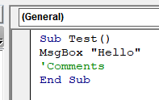
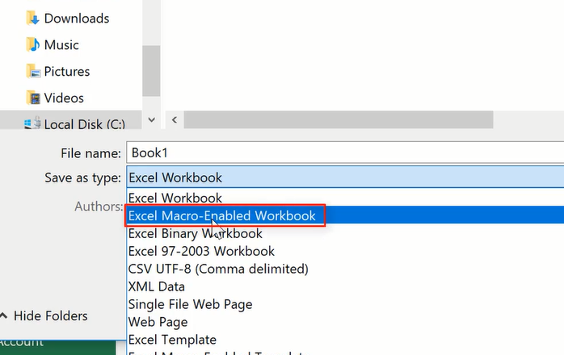
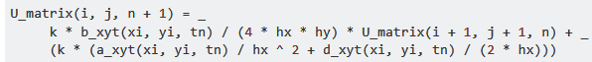
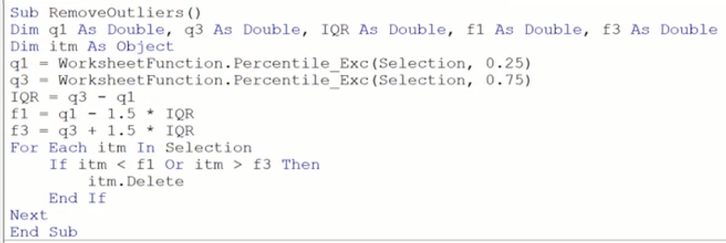
Weeks 1 - 2
Put ‘ in front to make comments in a similar way that # is used in Python
Save files as .xlsm
Record a Macro
Remember to stop recording
Naming of Macros cannot allow space so use _ e.g. Highlight_All
After recording Macro, can go into VBA Editor to review the code for the macro
Useful Quick Codes
Use the <space> _ at the end of a line to split a line and join the line below
Concatenate :To put strings and numbers into one sentence, use the & as a connector after the string, e.g.
1) MsgBox ("The final result is " & k)
2) “I am” & 8 & “years old.”
Remove rows containing blank cells in column A:
Removing outliers:

Slide 2
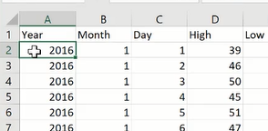
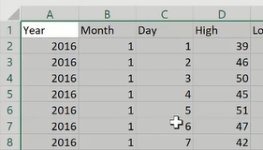
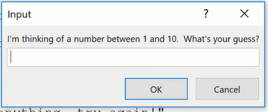
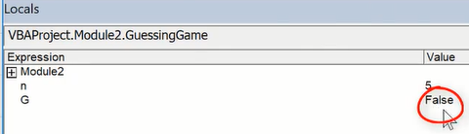
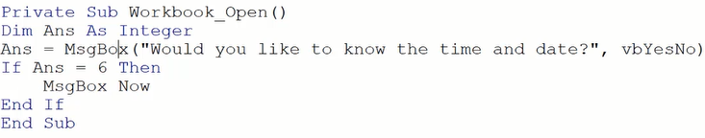
Selection of current block of cells (Ctrl+Shift+8)
Selection.CurrentRegion.Select
Count Rows or Columns:
Hide the screen updates when Macros are run:
Application.ScreenUpdating = False
Test if a number is an integer
CStr(CInt(G)) = G
Check if input is a number or string or blank, and then output MsgBoxes to tell user the problem
If IsNumeric(G) Then
<apply a condition or insert other If-Else loops>
ElseIf G = "" Then
MsgBox ("You didn't enter anything!")
Else
MsgBox ("Your guess must be a number!")
End If
ApplicationI.InputBox() deals with user clicking Cancel button or closes the box
The important thing about using the Application.InputBox method is it's been designed such that if the user cancels or closes out, the return value to whatever's on the left side of the equality is a false. Remember to set the type to 3. The appearance of this box is different
To the normal InputBox.
G = Application.InputBox(“I’m thinking of a number between 1 and 10. What is your?", , , , , , 3)
Allows the user to define a function in an InputBox and evaluate the function by replacing x with other values
Dim fxn as string
fxn = InputBox(“Enter function you wish to solve”)
For i =1 To 20
flow = Evaluate(Replace(fxn, “x”, low)
fhigh = Evaluate(Replace(fxn, “x”, high)
Output the current time and date

Slide 3
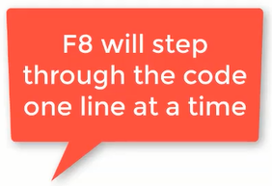
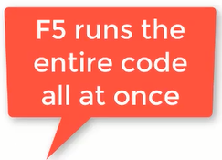
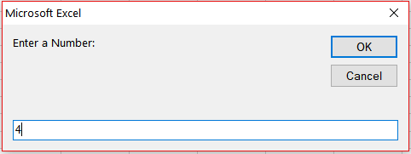
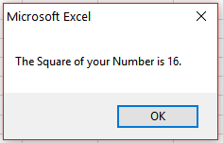
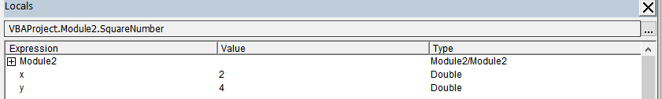
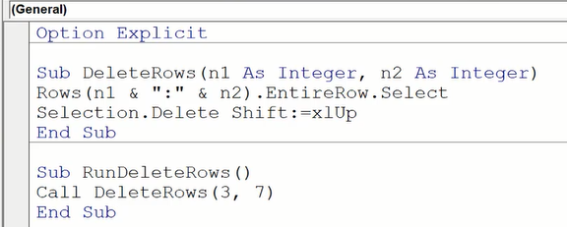
Creating Subs
Adding Option Explicit at the beginning allows VBE compiler to check for errors in the code, like misspellings. Have Option Explicit automatically displayed by going to VBE - > Tools -> Options -> Editor Tab -> select “Require Varibale Declaration”
Option Explicit
Sub SquareNumber()
‘Dim specifies the variable type
Dim x As Double, y As Double
x = InputBox("Enter a Number:")
y = x ^ 2
MsgBox ("The Square of your Number is " & y & ".")
End Sub
If the code is run line by line, then the Local Window shows what happens, e.g. the set up of variables, assigning of x, computation of y.
Examples:
This sub handles the deletion of rows
This sub calls the sub above and use it like a function

Slide 4
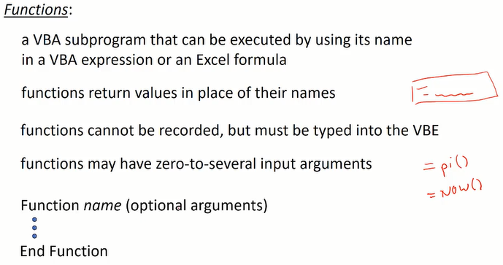
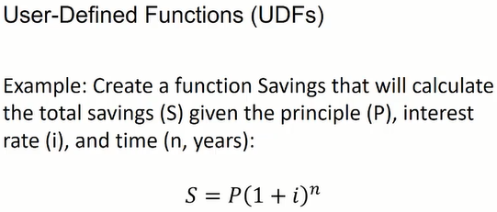
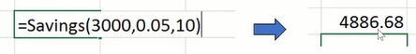
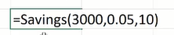
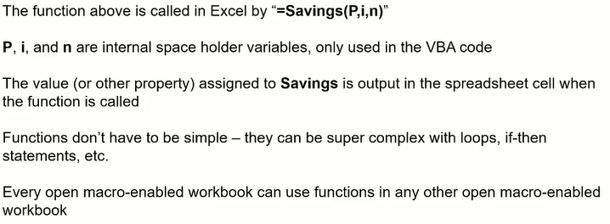
Functions
VBA Code:
Option Explicit
Function Savings(P As Double, i As Double, n As Integer)
Savings = P * (1 + i) ^ n
End Function
Run this code and then the function is ready to use in the workbook

Slide 5
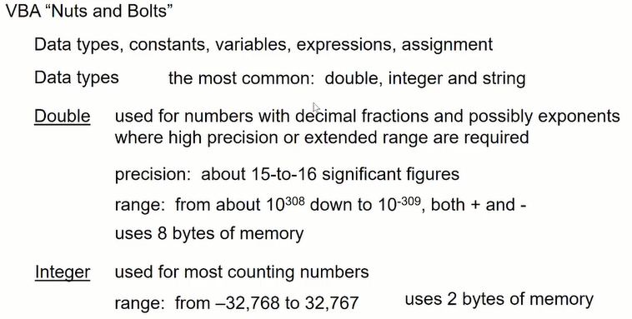
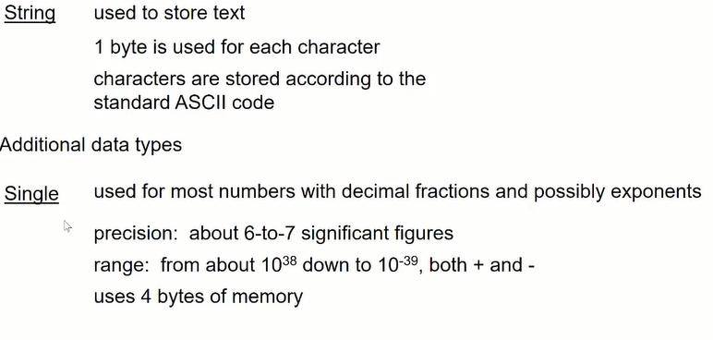
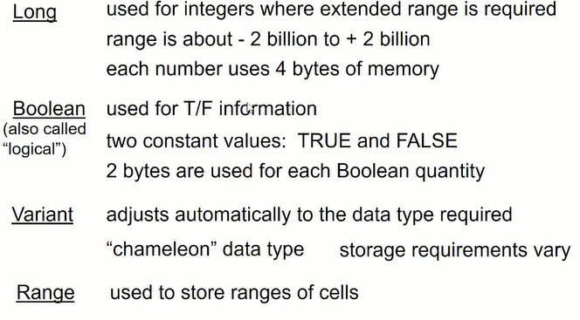
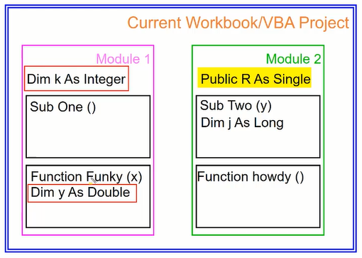

Slide 6
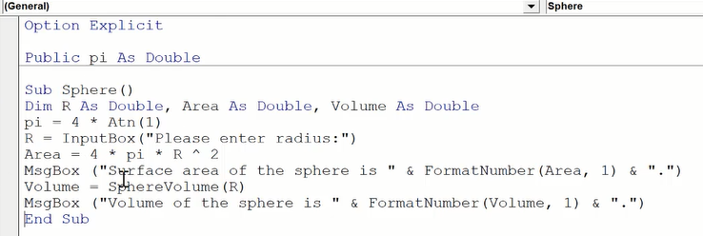
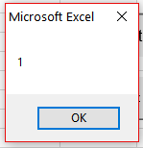
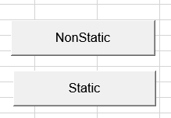
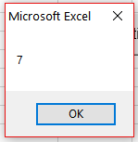
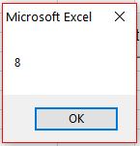
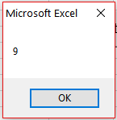
If there are several modules in the workbook and we don’t want to Dim pi all the time, then we can make pi Public so it is defined in all modules in the workbook
Option Explicit
Sub NonStaticExamples()
Dim d As Double
d = d + 1
MsgBox d
End Sub
Sub StaticExaples()
Static d As Integer
d = d + 1
MsgBox d
End Sub
Resets to 0 after each run
Keeps the value in memory

Slide 7
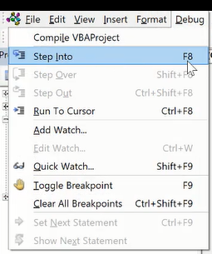
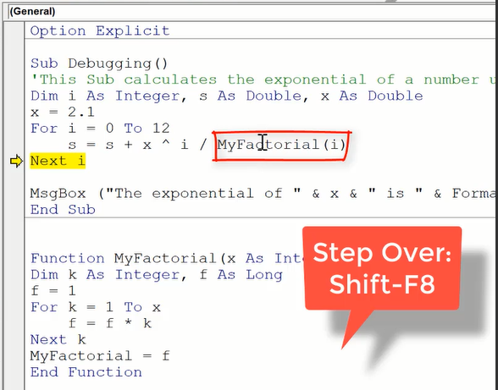
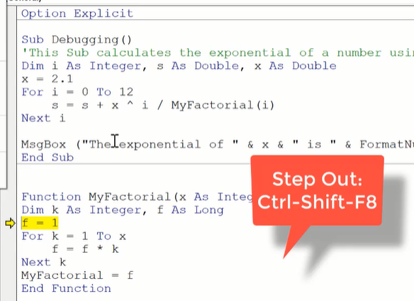
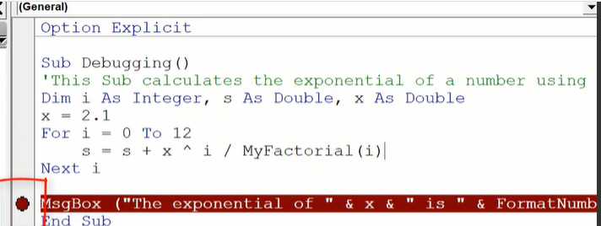
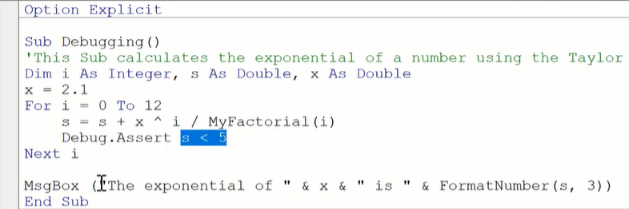
Debugging
F8 run the code line by line, so same as in Python / R and we can see what is going on in the Locals Window.
Then Shift+F8 allows stepping over a line that contains a function that is defined elsewhere to avoid jumping to that function so we remain focused in this section.
Ctrl+Shift+F8 is used when we step into a sub procedure and want to step out of it to return to the original section of code we were checking
Add break point by lift clicking on the left hand side.
Break point allows the code to run until it reaches that point, basically like a stop sign. And then you can kind of look at your code to see what's going on in Locals Window.
Can put “Debug.Assert s <5” function with a condition (s <5) of when to stop into the code. The code will run and enter into debug mode when the condition is FALSE, i.e s>5 in this example.
You actually have to right align of code.

Slide 8
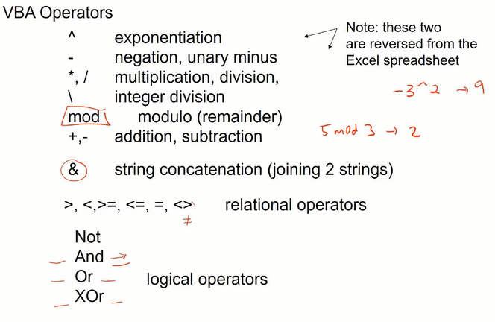
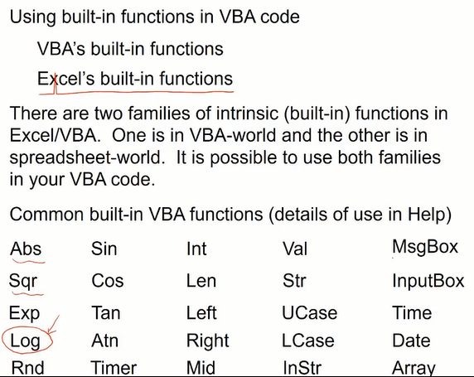
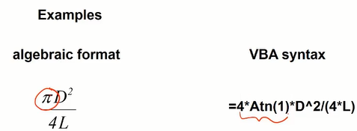
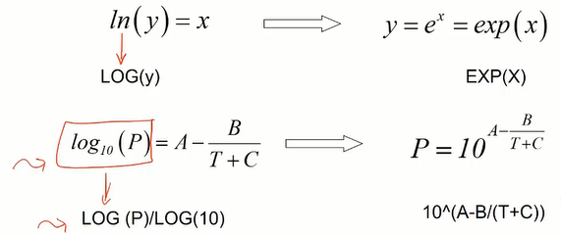
Operators
Exclusive means cannot be both true or both false, i.e.
x=2 XOr x=3
The identity tan(pi/4)=1 is used to define pi, so rearrange to give pi=4*Atn(1)

Slide 9
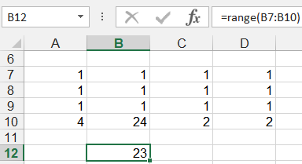
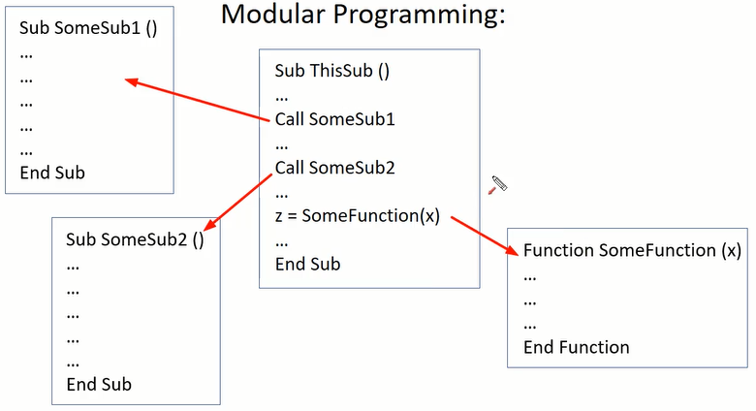
Convert a user-defined function to an Excel Add-In
If I made a User Define Function and want to use it on other computers or make it available for other people, then I could save the workbook containing the UDF as an “Add-in”. When then receive the Add-In file, they can go to
File -> Options -> Add-Ins -> click Go button -> click Browse button to load the Add-In file. Once loaded, they will be able to use the UDF in the worksheets.
Borrowing Excel functions
‘Here we borrowed Max and Min built-in functions and used them to create a range function
Function range(rng As range) As Double
range = WorksheetFunction.Max(rng) - WorksheetFunction.Min(rng)
End Function
An introduction to modular programming
So each of these functions and subs, these procedures, works on its own and then you kind of put them together into a modular program.

Slide 10
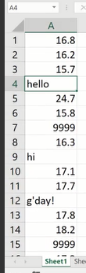
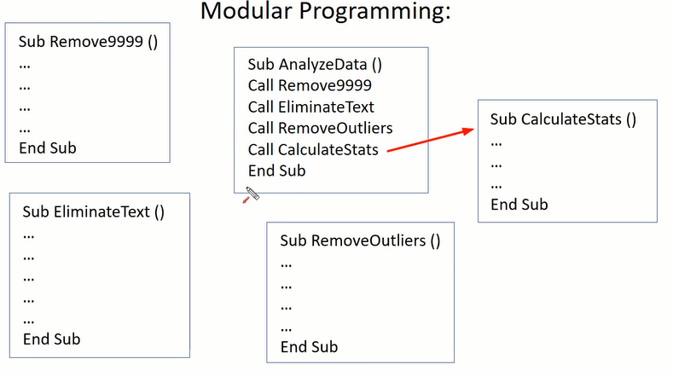
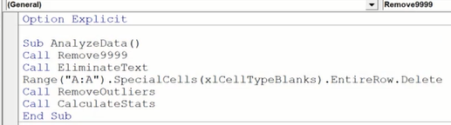
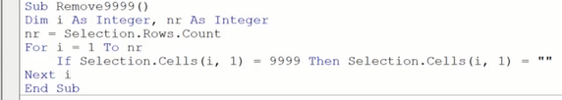
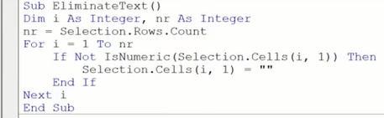
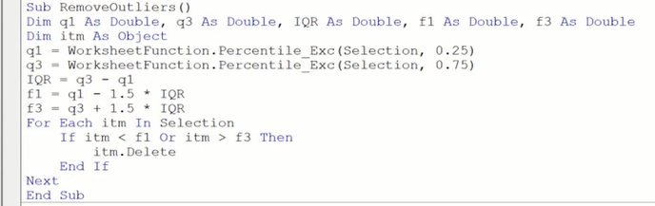
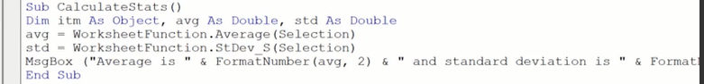
We want to clean and analyze the data by creating a modular program

Slide 11
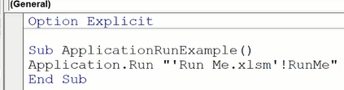
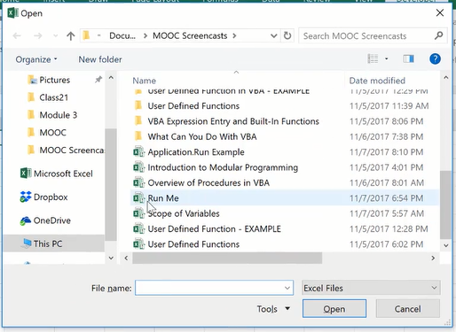
Running a subroutine that resides in another file
1) Simple way but leave the Sub file open after you’ve run the code
The Run Me.xlsm files doesn’t have to be opened to be called
If there is no space in file name, can leave out the ‘ ‘
File name
Connector
Name of Sub
2) A modified way to allow us to select the file containing the Sub and the Sub file will be closed without saving
any changes after being called
Sub ApplicationRunExample()
Dim FileName As String, aWB As Workbook
FileName = Application.GetOpenFilename("Excel Files (*.xlsm), *.xlsm")
Workbooks.Open FileName
Set aWB = ActiveWorkbook
Application.Run "Run Me.xlsm'!RunMe"
aWB.Close SaveChanges:=False
End Sub
Add these lines above and below the Application.Run “Run Me.xlsm'!RunMe"
code to get a file selection box and close the RunMe Sub after being used in ApplicationRunExample Sub

Slide 12



Week # - Reference to Objects

Slide 13











Object
Property

Slide 14












(“D:F”)
E4
So Range("A2:C6") would be this region. Range("B2") means Range("B2") of that range. So, you can imagine the region I have selected here is its own new spreadsheet, in Range("B2") then of A2 to C6 would be that cell. So, I can run this and it outputs negative two.

Slide 15











You can't just write Selection.Count on it's own or it'll give you an error because this is returning a value.

Slide 16





Sub SquareRoot()
Dim x As Double, y As Double
x = InputBox ("Enter value of x:")
y = Sqr(x)
MsgBox ("The square root of your number is " & FormatNumber(y, 2) & ".")
End Sub

Slide 17






Sub SquareRoot()
Dim x As Double, y As Double
x = Range(“A1”)
y = Sqr(x)
MsgBox ("The square root of your number is " & FormatNumber(y, 2) & ".")
End Sub
Sub Example3()
Dim x As Double, y As Double
x = Selection.Range("B2")
y = x ^ 2
Range("A1") = y
End Sub
Sub Example3()
Dim nr As Double, nc As Double
nr = Selection.Rows.Count
nc = Selection.Columns.Count
MsgBox "nr is " & nr & " and nc s " & nc & "."
End Sub
Sub Example5()
Dim x As Double, y As Double
x = InputBox("Value of x")
y = ActiveCell + x
ActiveCell.Offset(2, 2) = y
End Sub
Sub Example5()
Dim x As Double
x = InputBox("Value of x")
ActiveCell.Offset(2, 2) = ActiveCell + x
End Sub

Slide 18
Example 6
Add cell A1 to a value x that's input by the user in an input box to give z.
And then ask user for a range using input box. And place z in that range
Sub Example6()
Dim x As Double, z As Double, rng As String
x = InputBox("Value of x")
z = Range("A1") + x
rng = InputBox("Input Range to place z")
Range(rng) = z
End Sub

Slide 19

How to handle basic user error in your subroutines
A good way is to add “On Error GoTo Here” under the Dim line, and add the lines
Here:
MsgBox (“There was an error!”)
End Sub
after the End Sub of the code

Slide 20









Wee 4
Selection: Owo Way (If-Then-End)
Or

Slide 21





Selection: Two Way (If-Then-Else)

Slide 22




Slide 23





Selection: Multiple (If-Then-ElseIf)
https://www.coursera.org/learn/excel-vba-for-creative-problem-solving-part-1/lecture/f7GZv/all-about-the-multi-alternative-if-then

Slide 24




Repetition: Loops
https://www.coursera.org/learn/excel-vba-for-creative-problem-solving-part-1/lecture/ui465/variable-iteration-loops-do-loops

Slide 25




Do-While
So if set i=35 at the beginning, it will skip over to End Sub

Slide 26



Do-Until

Slide 27






Do Loops Examples
https://www.coursera.org/learn/excel-vba-for-creative-problem-solving-part-1/lecture/R225P/validating-user-input-using-a-do-loop
1) Inside the Do Loop, we first ask user for the percentage,
and then test to make sure between 0 and 100.
2) If true, we exit the Do Loop.
3) If false, we want to first provide the user with a correction message, and then loop back to the initial Do Loop.
So this is input validation procedure.
https://www.coursera.org/learn/excel-vba-for-creative-problem-solving-part-1/lecture/9wtEw/creating-a-guessing-game-using-a-do-loop
and 10”)

Slide 28






Count-Controlled Loop (For-Next)
https://www.coursera.org/learn/excel-vba-for-creative-problem-solving-part-1/lecture/LK9KB/all-about-fixed-iteration-for-next-loops

Slide 29




Slide 30






Put Everything Together
https://www.coursera.org/learn/excel-vba-for-creative-problem-solving-part-1/lecture/tU61x/putting-it-all-together-example-1
We can use Selection.Cells(i, 1) to reference the cells
i, 1) = -998 Then
Or
Alternatively, we can use ActiveCell.Offset(1, 0) to reference the cells

Slide 31










https://www.coursera.org/learn/excel-vba-for-creative-problem-solving-part-1/lecture/trGtF/putting-it-all-together-example-2
The way bubble sort works is start with initial column of values and do pairwise comparisons.
We first compare item one with item two, If they are not in ascending order, then make a swap.
Next, we move on to items two and three and so on.
If there are n numbers, you have to do (n-1) comparisons and (n-1) passes.
This is the (n-1) passes
This is the (n-1) comparisons in each pass to move the lowest number to the top
This is how the swap mechanism works
1) Then
1)

Slide 32






Implementation of For-Next Loop
And For-Each Loop to do a search
For-Next
https://www.coursera.org/learn/excel-vba-for-creative-problem-solving-part-1/lecture/IMNyM/using-the-for-each-next-statement
What we're trying to do in this example is:
1) For a selection, find the 7s.
2) List the rows containing 7s in column
3) Implement a Reset to clear column C after
we have the results in column C
First we set up a core of the code to search for 7s, use the count to place the row number (i) into column C, and have a reset of column “C”
we have to modify the code and add in order to display “7 found in row:” in cell C1, but because C1 is taken, so we have to modify the code to allow the row numbers to appear starting from C2 instead of C1

Slide 33


For-Each
https://www.coursera.org/learn/excel-vba-for-creative-problem-solving-part-1/lecture/IMNyM/using-the-for-each-next-statement
Can use the For-Each loop by assigning
Each item in a range.
If your selection doesn't start in A1, but starting at A6, the code is not going to give you the row number in the selection. In other words, if I made this as my selection, as shown on the left, the first 7 will be found in row 10, and not row 5.

Slide 34



Real-World Example of For-Next Loop
https://www.coursera.org/learn/excel-vba-for-creative-problem-solving-part-1/lecture/EPsy4/worked-mini-project-searching-through-high-and-low-temperatures-in-an-excel
Objective
1) Look through these to see which days exceeded, for example, a temperature of 90 degrees.
Which days had a low of less than a certain value.
Include a reset button as well,
Sub HighTemp()
Dim nr As Integer, i As Integer, HT As Double, c As Integer
Call Reset
Range("A2").Select
Application.ScreenUpdating = False
Selection.CurrentRegion.Select
HT = InputBox("Display the days in the year that exceeds temp of")
nr = Selection.Rows.Count
For i = 2 To nr
If Selection.Cells(i, 4) > HT Then
c = c + 1
If c = 1 Then
Range("G1") = "Date"
Range("H1") = "Temperature"
End If
Range("G" & c + 1) = Selection.Cells(i, 2) & "/" & Selection.Cells(i, 3)
Range("H" & c + 1) = Selection.Cells(i, 4)
End If
Next i
Range("A2").Select
End Sub
Sub LowTemp()
Dim nr As Integer, i As Integer, LT As Double, c As Integer
Call Reset
Application.ScreenUpdating = False
Range("A2").Select
Selection.CurrentRegion.Select
LT = InputBox("Display the days in the year that had temp lower than")
nr = Selection.Rows.Count
For i = 2 To nr
If Selection.Cells(i, 5) < LT Then
c = c + 1
If c = 1 Then
Range("G1") = "Date"
Range("H1") = "Temperature"
End If
Range("G" & c + 1) = Selection.Cells(i, 2) & "/" & Selection.Cells(i, 3)
Range("H" & c + 1) = Selection.Cells(i, 5)
End If
Next i
Range("A1").Select
End Sub
Sub Reset()
Columns("G:H").Clear
End Sub

Slide 35


Advanced Guessing Game
https://www.coursera.org/learn/excel-vba-for-creative-problem-solving-part-1/lecture/zKwhl/optional-advanced-input-validation-and-error-handling-part-1
The standard code for the guessing game is shown below, and it was taught earlier:
Sub GuessingGame()
Dim n As Integer, G As Integer
n = WorksheetFunction.RandBetween(1, 10)
Do
G = InputBox("I’m thinking of a number between 1 and 10. What is your?")
If G = n Then Exit Do
MsgBox ("Guess again!")
Loop
MsgBox ("Congrtulations! You guessed the number!")
End Sub
We are going to make some improvements to the guessing Game code such that:
We want a message box remind user to input 1 to 10 if they entered a string or outside of 1 to 10
It doesn’t crash if user clicked OK without entering a number
It doesn’t crash if user clicked Cancel button or the close button

Slide 36


Sub GuessingGame()
Dim n As Integer, G As Integer
On Error GoTo Here
n = WorksheetFunction.RandBetween(1, 10)
Do
Do
G = InputBox("I’m thinking of a number between 1 and 10. What is your?")
If G <= 10 And G >= 0 Then
Exit Do
ElseIf G > 10 Then
MsgBox ("Guess must not exceed 10! Try Again.")
ElseIf G < 1 Then
MsgBox ("Guess must not be less than 1! Try Again.")
End If
Loop
If G = n Then Exit Do
MsgBox ("Guess again!")
Loop
MsgBox ("Congrtulations! You guessed the number!")
Exit Sub
Here:
MsgBox ("An error has occured")
End Sub

Slide 37

We want to be more specific and examine if the user has input an integer, so all three conditions have to be satisfied in order to continue with the guessing game
Sub GuessingGame()
Dim n As Integer, G As Double
On Error GoTo Here
n = WorksheetFunction.RandBetween(1, 10)
Do
Do
G = InputBox("I’m thinking of a number between 1 and 10. What is your?")
If G <= 10 And G >= 0 And CStr(CInt(G)) = G Then
Exit Do
ElseIf G > 10 Then
MsgBox ("Guess must not exceed 10! Try Again.")
ElseIf G < 0 Then
MsgBox ("Guess must not be less than 0! Try Again.")
ElseIf CStr(CInt(G)) <> G Then
MsgBox ("Guess must be an integer! Try Again.")
End If
Loop
If G = n Then Exit Do
MsgBox ("Guess again!")
Loop
MsgBox ("Congrtulations! You guessed the number!")
Exit Sub
Here:
MsgBox ("An error has occured")
End Sub

Slide 38

We want check right at the beginning whether user has input a string or a number, or if they left the input blank
Sub GuessingGame()
Dim n As Integer, G As Double
On Error GoTo Here
n = WorksheetFunction.RandBetween(1, 10)
Do
Do
G = Application.InputBox("I’m thinking of a number between 1 and 10. What is your?", , , , , , 3)
If G = False Then Exit Sub
If IsNumeric(G) Then
If G <= 10 And G >= 0 And CStr(CInt(G)) = G Then
Exit Do
ElseIf G > 10 Then
MsgBox ("Guess must not exceed 10! Try Again.")
ElseIf G < 0 Then
MsgBox ("Guess must not be less than 0! Try Again.")
ElseIf CStr(CInt(G)) <> G Then
MsgBox ("Guess must be an integer! Try Again.")
End If
ElseIf G = "" Then
MsgBox ("You didn't enter anything!")
Else
MsgBox ("Your guess must be a number!")
End If
Loop
If G = n Then Exit Do
MsgBox ("Guess again!")
Loop
MsgBox ("Congrtulations! You guessed the number!")
Exit Sub
Here:
MsgBox ("An error has occured")
End Sub

Slide 39







Goal Seek

Slide 40





Slide 41






Solver

Slide 42









Slide 43



Automating Goal Seek and Solver
Record the Goal Seek or Solver procedures using Macro recording. Then go into VBA and copy those codes into your Subs.
In another Module, create your Subs and make Fro-Next Loops to repeat the optimization processes and place data into the table
Modify the GoalSeek or Slover codes at “Goal:=“ and “ValueOf:=”. Then add a line to place the optimized number into the correct place of table
If the solver code has a function error, then go to VBA’s Tools Tabl -> References -> check the Solver Box

Slide 44








Circular Calculation
There will be an error if you try to do iterations without the correct settings, so follow the red box instructions.
Now it works!
Sometimes one form of the equation won’t work, so need to rearrange the equation to another form and try the iteration again

Slide 45









Bisection Method – Make live changes
So we can eliminate the blue section

Slide 46



Now we apply the bisection method to solving the Fuel Tank problem, see the file called Fuel-Tank Bisecting Method Live Solution.xlsm
https://www.coursera.org/learn/excel-vba-for-creative-problem-solving-part-1/lecture/5rZ3x/implementing-a-live-solution-of-the-bisection-method-to-solve-a-case-study

Slide 47




Golden Ratio Method
After we have d, we're going to calculate this parameter known x1, which is d above a. We then go down a value d from b to compute x2. Next, we find f(x1) and f(x2), and we do a comparison between those two function values. If f(x1) is less than f(x2) as shown in this diagram, then that means that we're going to eliminate everything to the left of x2. So we're just going to cross all that out similar to bisection, where you're eliminating a lot of your integral. Now in this case we're not quite eliminating 50% as we did in the bisection method. We're eliminating about 38%, which is 1 minus the golden ratio. So if this happens, then x2 becomes the new a.

Slide 48






Slide 49










Slide 50













Golden Ratio Method to make live solution
After setting up the table frame above, we need to decide which shape the line is. In this case, it looks like if θ is small, it will take the longest time, so it is the blue line
No we put formulas into cells to create the Golden Ratio Method to find the minimum value of θ.
Copy and paste fx1 into fx2 because it is using relative cell referencing
Copy d to fx2 down to line 2
Copy the entire row 2 and drag down to 20 iterations
Change cell C3 to =AVERAGE(fx1, fx2) at the 20th iteration, then divide by 60 to get answer into minutes.

Slide 51





Creating a VBA Sub() to Implement the Bisection Method

Slide 52


Creating a VBA Sub() to Implement the Circular Calculation

Slide 53



Creating a VBA Sub() to Implement the Golden Search

Slide 54




Creating a VBA Function using Bisection Method for Fuel Tank Problem
Instead of a table showing h, we want to use VBA Sub to create a function called TankVloume(Rad, L, Vol) which will output h. So basically we are solving for the root of the equation f(h) using the bisection method.
Now we try the Function to find h for a user defined set of parameters (Rad, L , Vol), and it works to give 5.4 inches

